Slide 2
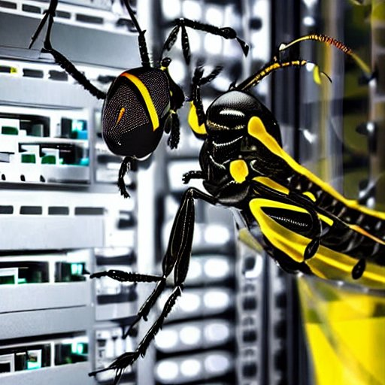
Security of Machine Learning Systems
Shain Singh | shain.singh@owasp.org | @shainsingh

Slide 3

Security of Machine Learning Systems
{
"$schema": "https://raw.githubusercontent.com/jsonresume/resume-schema/v1.0.0/schema.json",
"basics": {
"name": "Shain Singh",
"label": "Principal Security Architect, OCTO, OSPO @ F5 | Project Co-Lead @ OWASP"
},
"profiles": [
{
"network": "LinkedIn",
"url": "https://www.linkedin.com/in/shsingh/"
},
{
"network": "Twitter",
"url": "https://twitter.com/shainsingh"
},
{
"network": "Github",
"url": "https://github.com/shsingh"
}
],
"work": [
{
"name": "OWASP® Foundation",
"position": [
"Project Co-Lead - Machine Learning Security Top 10",
"Project Co-Lead - Machine Learning Security Verification Standard"
]
},
{
"name": "Cloud Security Alliance",
"position": [
"DevSecOps Working Group",
"Zero Trust Working Group"
]
},
{
"name": "F5",
"position": [
"Open Source Program Office (OSPO) - Open Source Advocate",
"Office of CTO (OCTO) - Innovation Ambassador",
"Principal Security Architect [APCJ]"
]
}
]
}
curl –L whois.shain.io

Slide 4
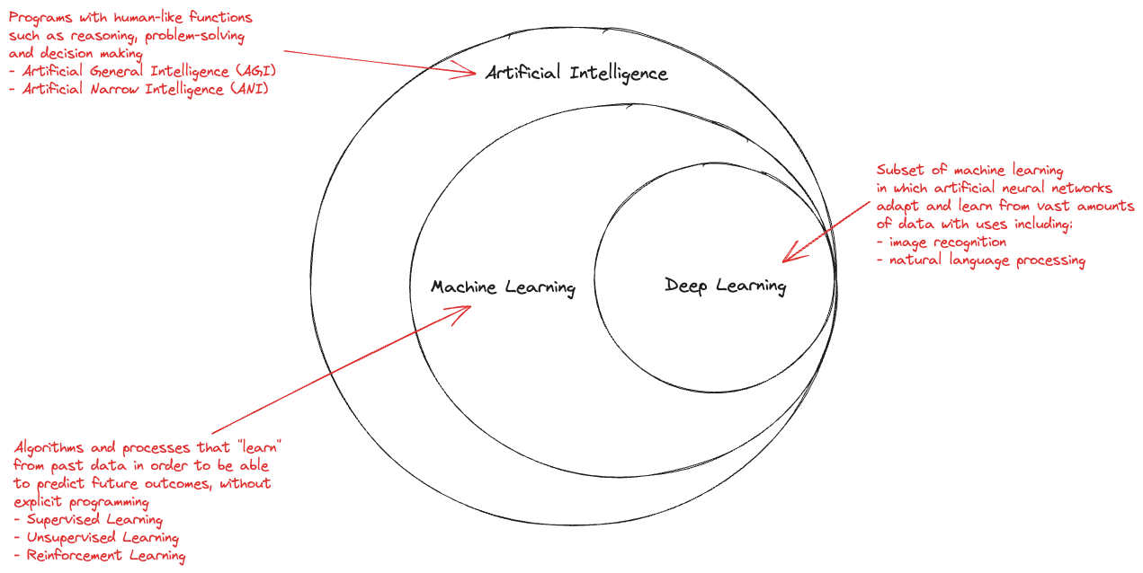
Security of Machine Learning Systems
Let’s start with some definitions

Slide 5
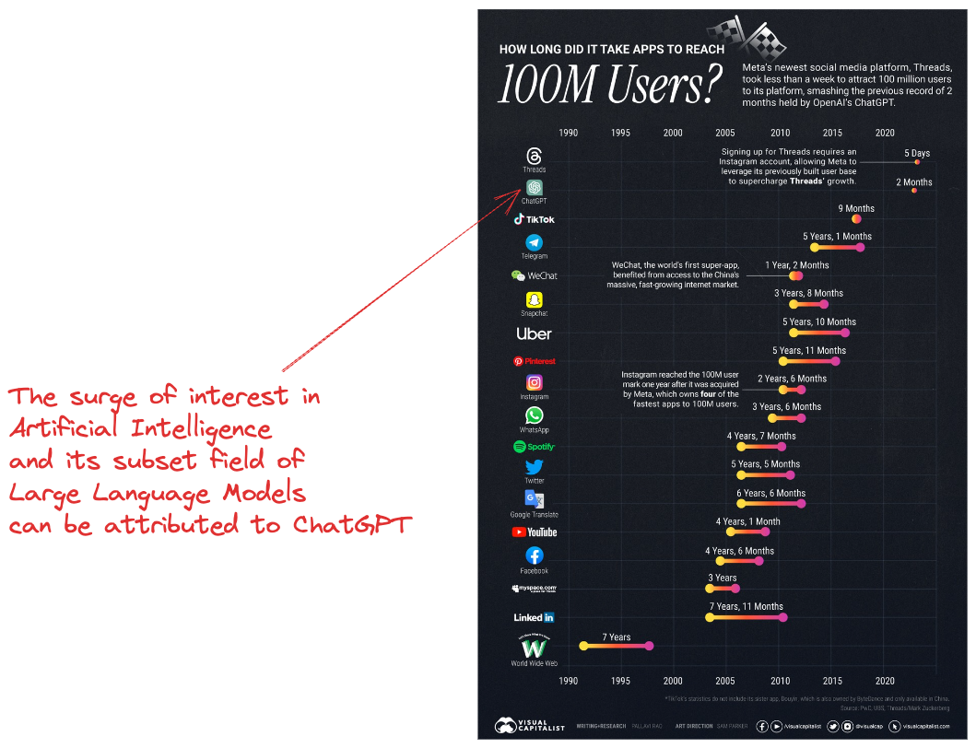
Security of Machine Learning Systems
Why is AI so hot in 2023?

Slide 6
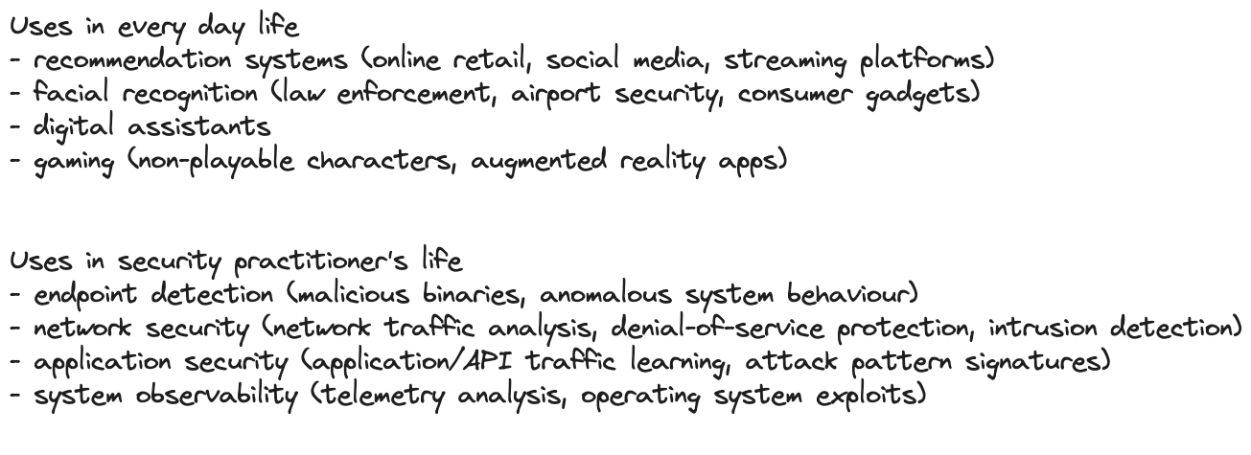
Security of Machine Learning Systems
AI usage is certainly not new

Slide 7
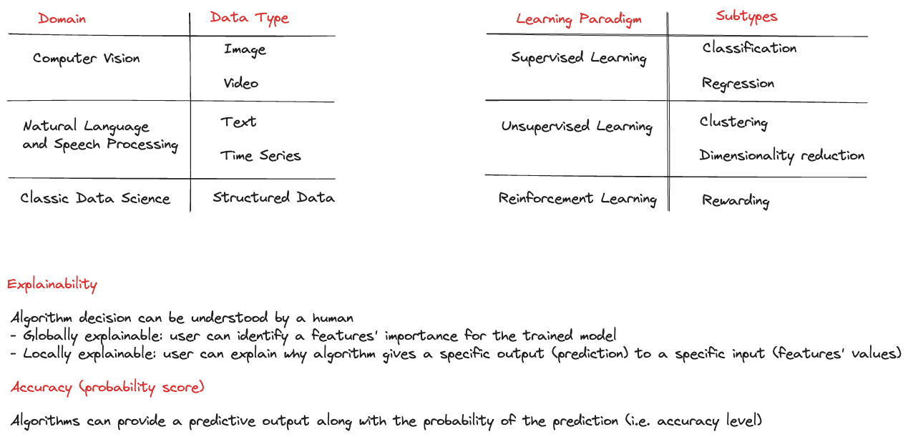
Security of Machine Learning Systems
Some ML taxonomy to be familiar with

Slide 8
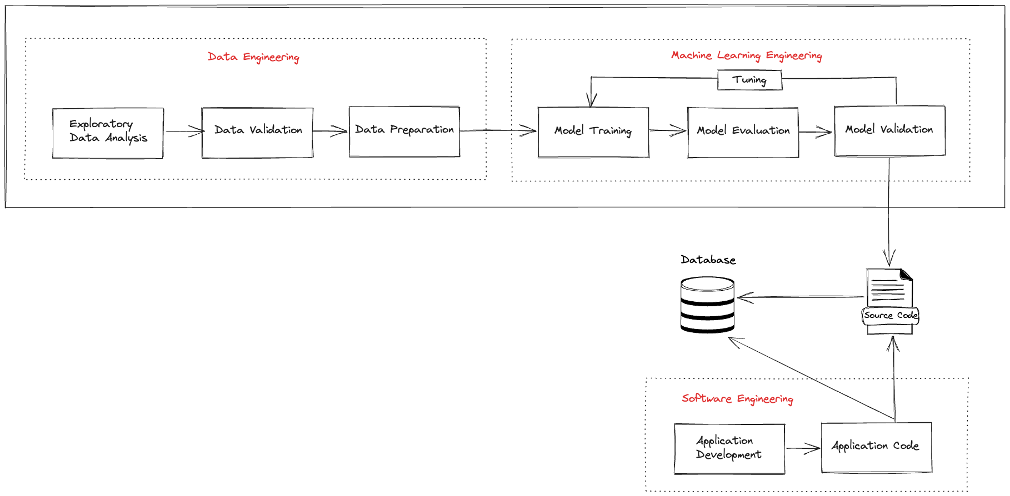
Security of Machine Learning Systems
Integrating software with ML

Slide 9
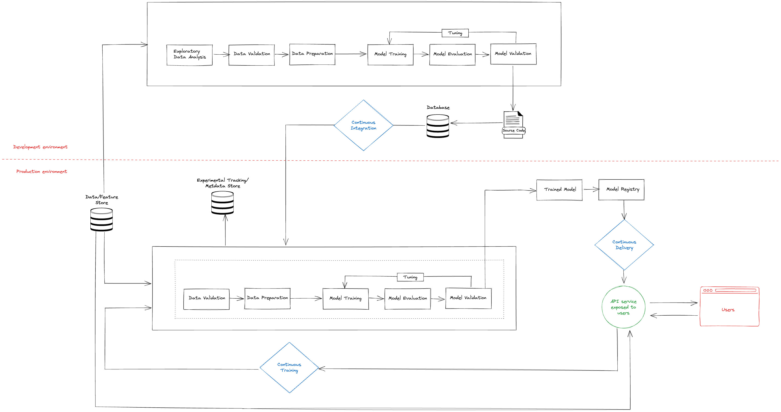
Security of Machine Learning Systems
Using ML in production

Slide 10
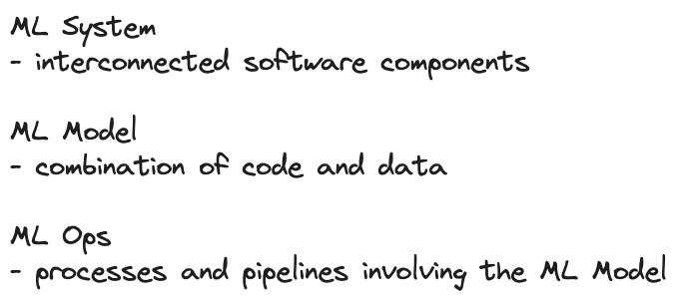
Security of Machine Learning Systems
Let’s oversimplify things to help us understand

Slide 11
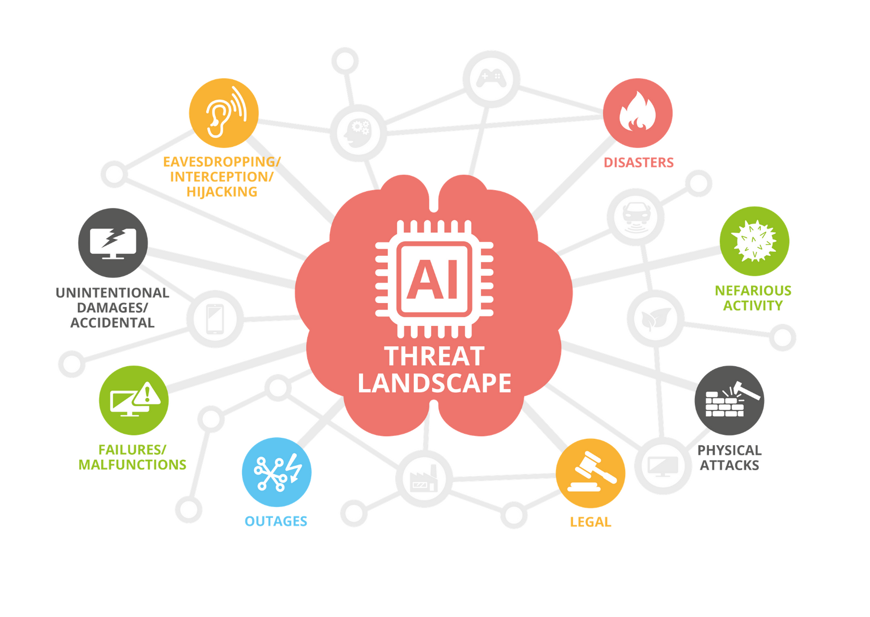
Security of Machine Learning Systems
Threat landscape for AI
https://www.enisa.europa.eu/publications/artificial-intelligence-cybersecurity-challenges

Slide 12
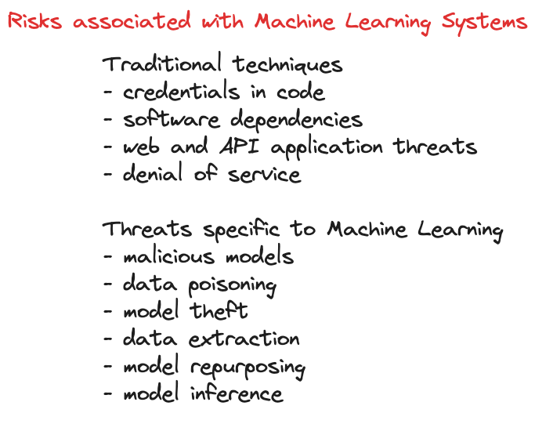
Security of Machine Learning Systems
ML Engineer != Software Engineer != AppSec Engineer

Slide 13
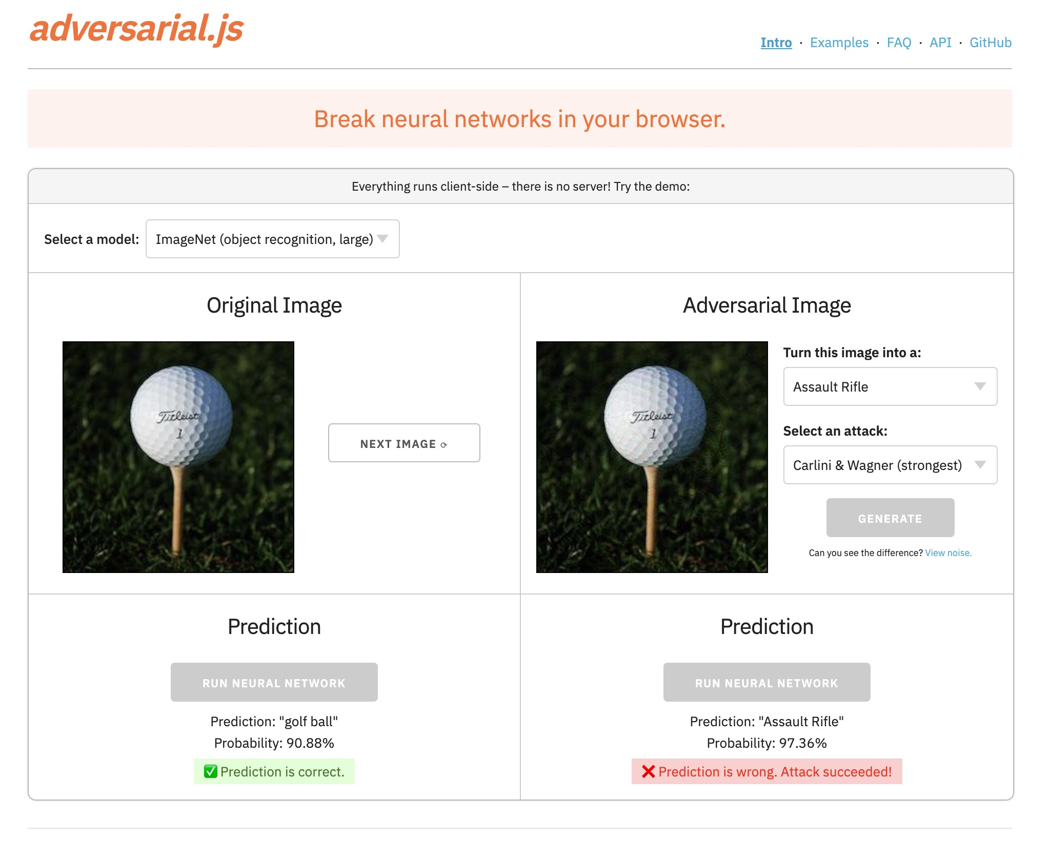

Security of Machine Learning Systems
Examples of Adversarial Attacks
https://kennysong.github.io/adversarial.js/

Slide 14
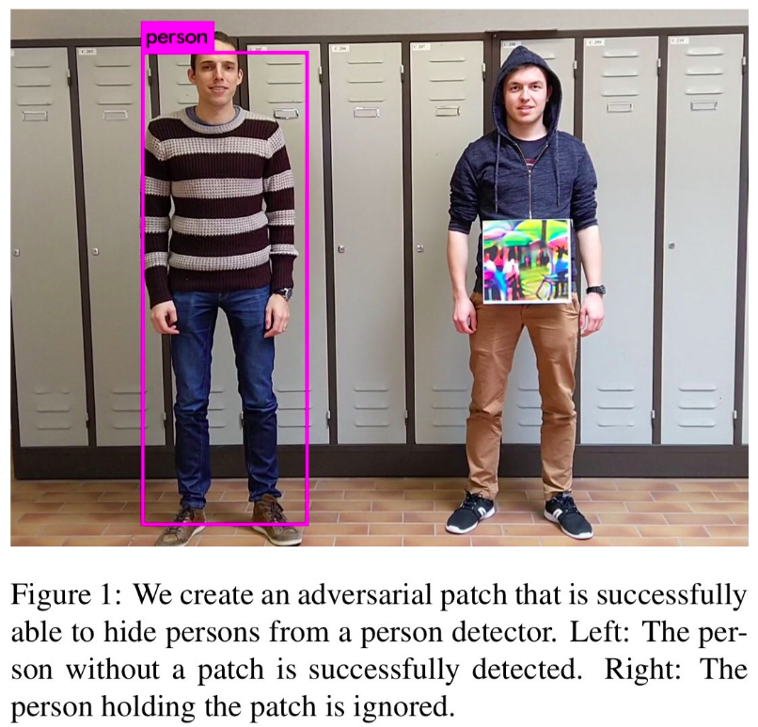
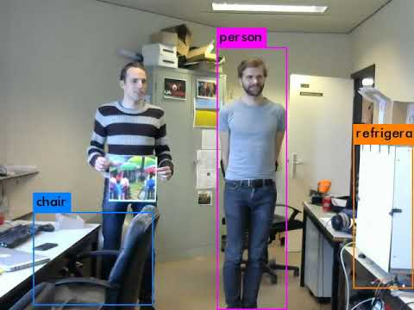
Security of Machine Learning Systems
Examples of Adversarial Attacks

Slide 15
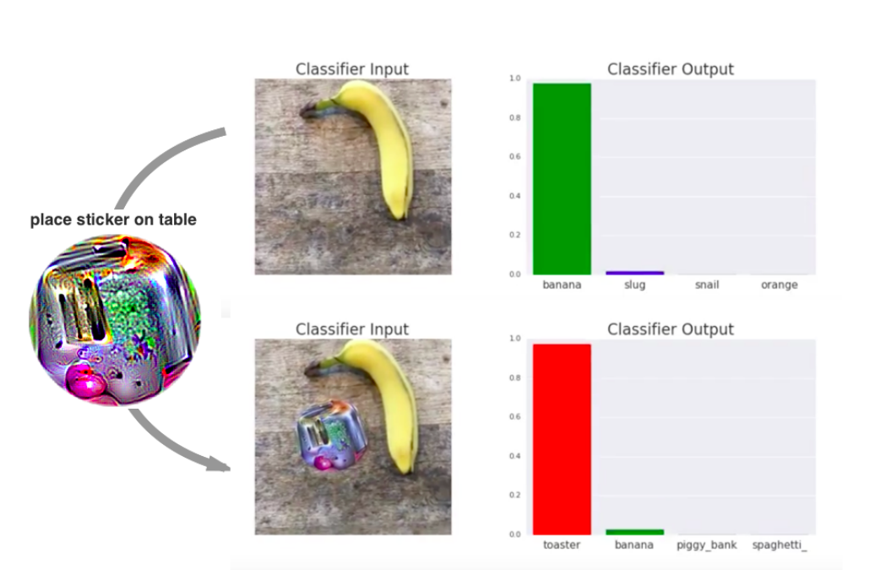


Security of Machine Learning Systems
Examples of Adversarial Attacks
https://arxiv.org/pdf/1712.09665.pdf
https://arxiv.org/pdf/1910.06261.pdf

Slide 16
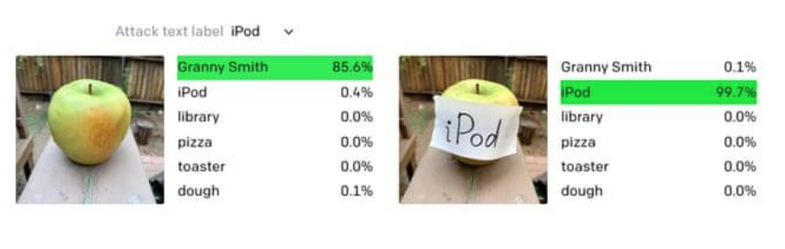
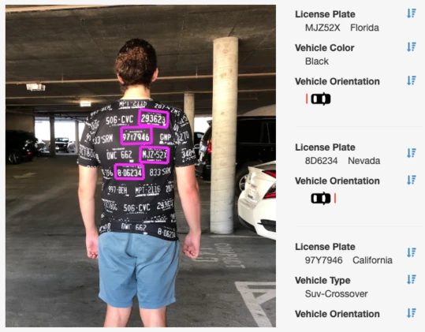
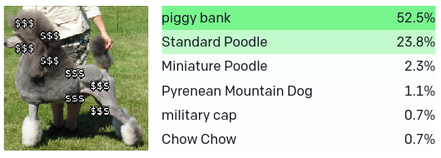
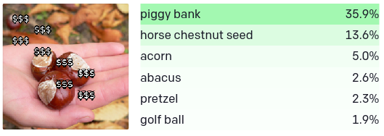
Security of Machine Learning Systems
Examples of Adversarial Attacks
Ref: https://adversarialfashion.com/
https://openai.com/blog/multimodal-neurons/

Slide 17
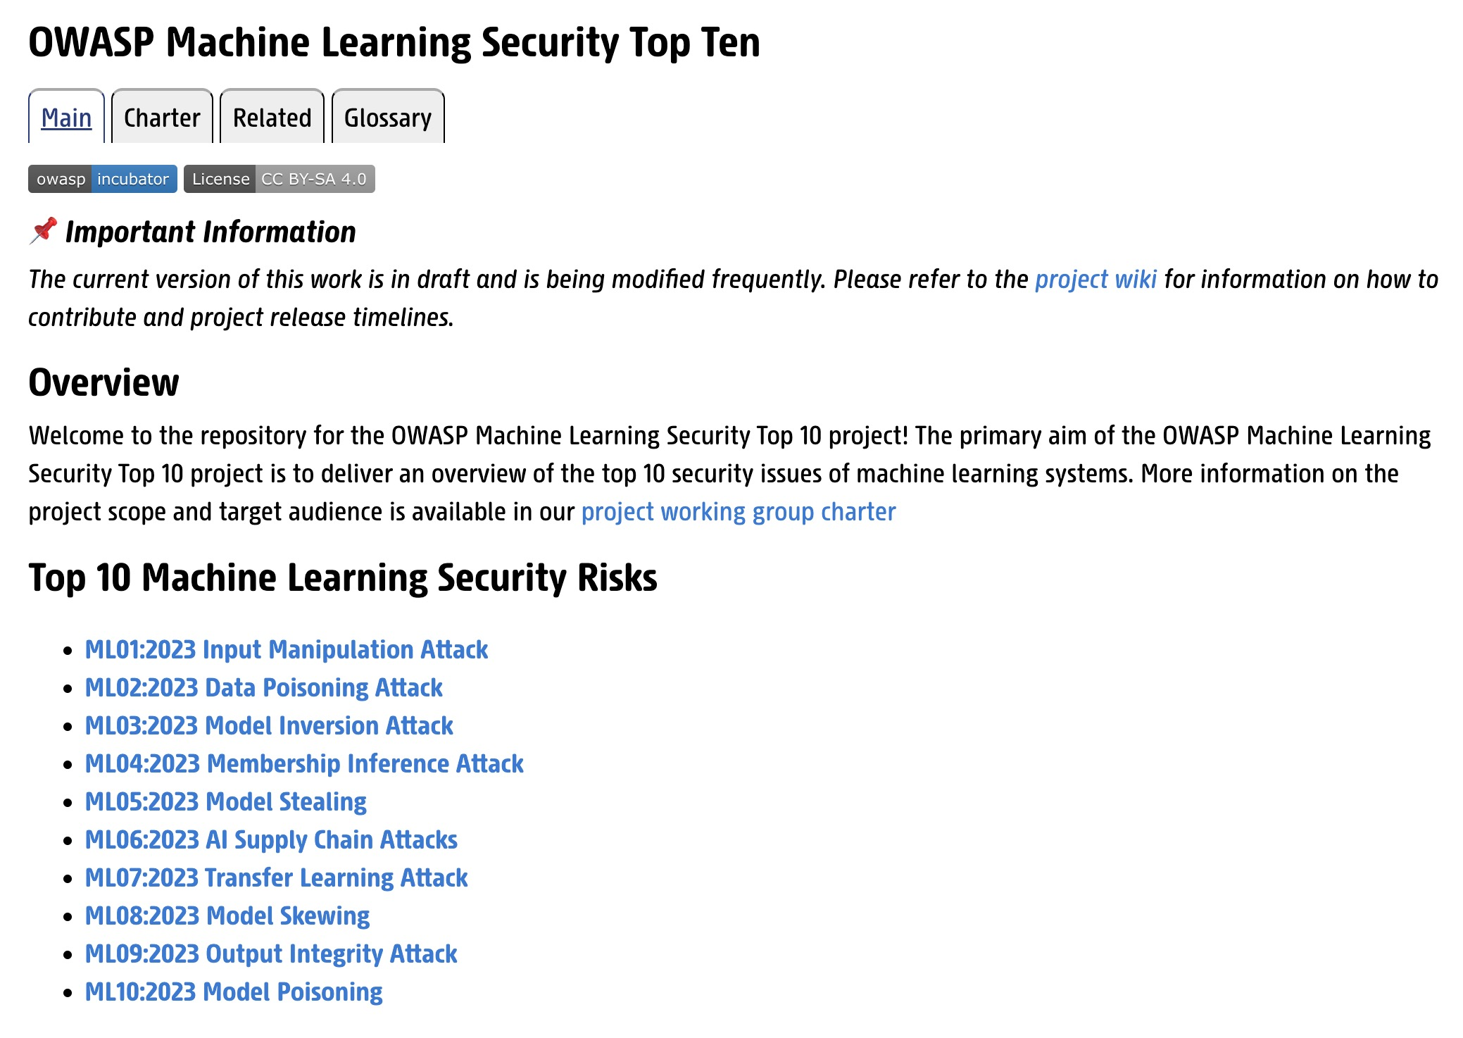
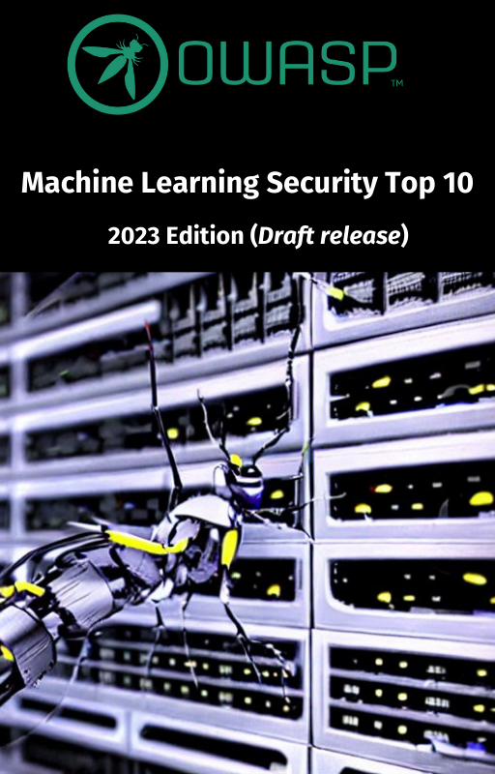
Security of Machine Learning Systems
Introducing the OWASP ML TOP 10 Project
https://mltop10.info

Slide 18
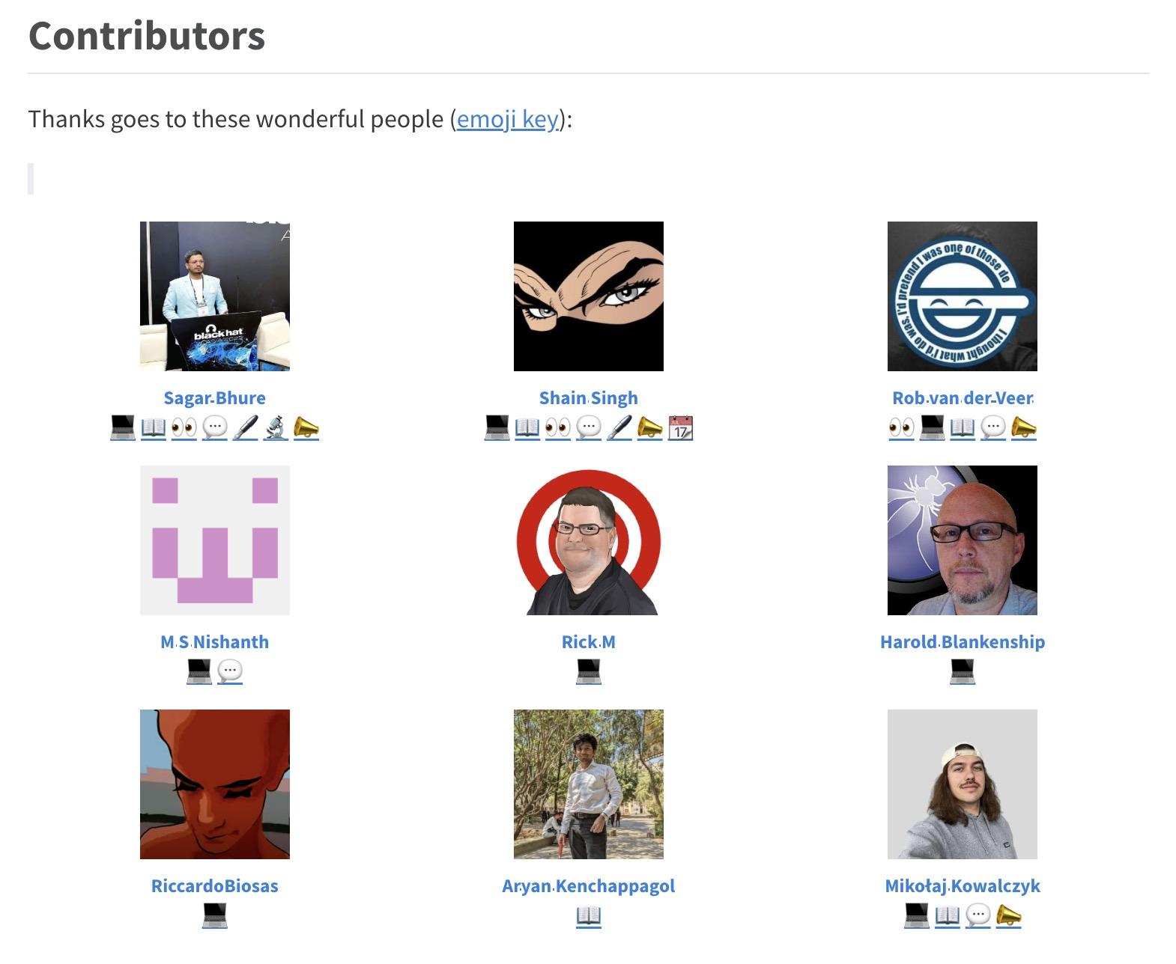
Security of Machine Learning Systems
We would love to see your name here!

